Slide 1
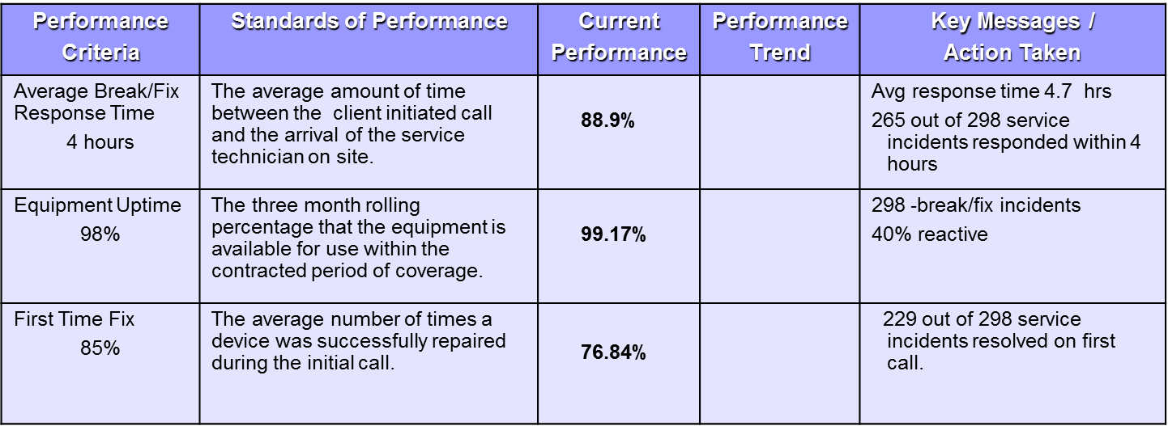
Standards of Performance Scorecard
Page 4
Notes:
No Yellow – We are either achieving SLA’s or Not
Share SLA’s with Associates
Hints & Tips:
Customize these according to contracted Standards Of Performance (SOP) / Service Level Agreements (SLA) not Statement of Work (SOW)
Consider discussing the differences in Standards of Performance / Statements of Work / Service Level Agreements

